Slide 1


The opportunities of an ageing society: looking beyond the challenges
Annual McClelland Lecture, Alliance Manchester Business School
31 January 2018
Anna Dixon, Chief Executive
@DrAnnaDixon

Slide 2
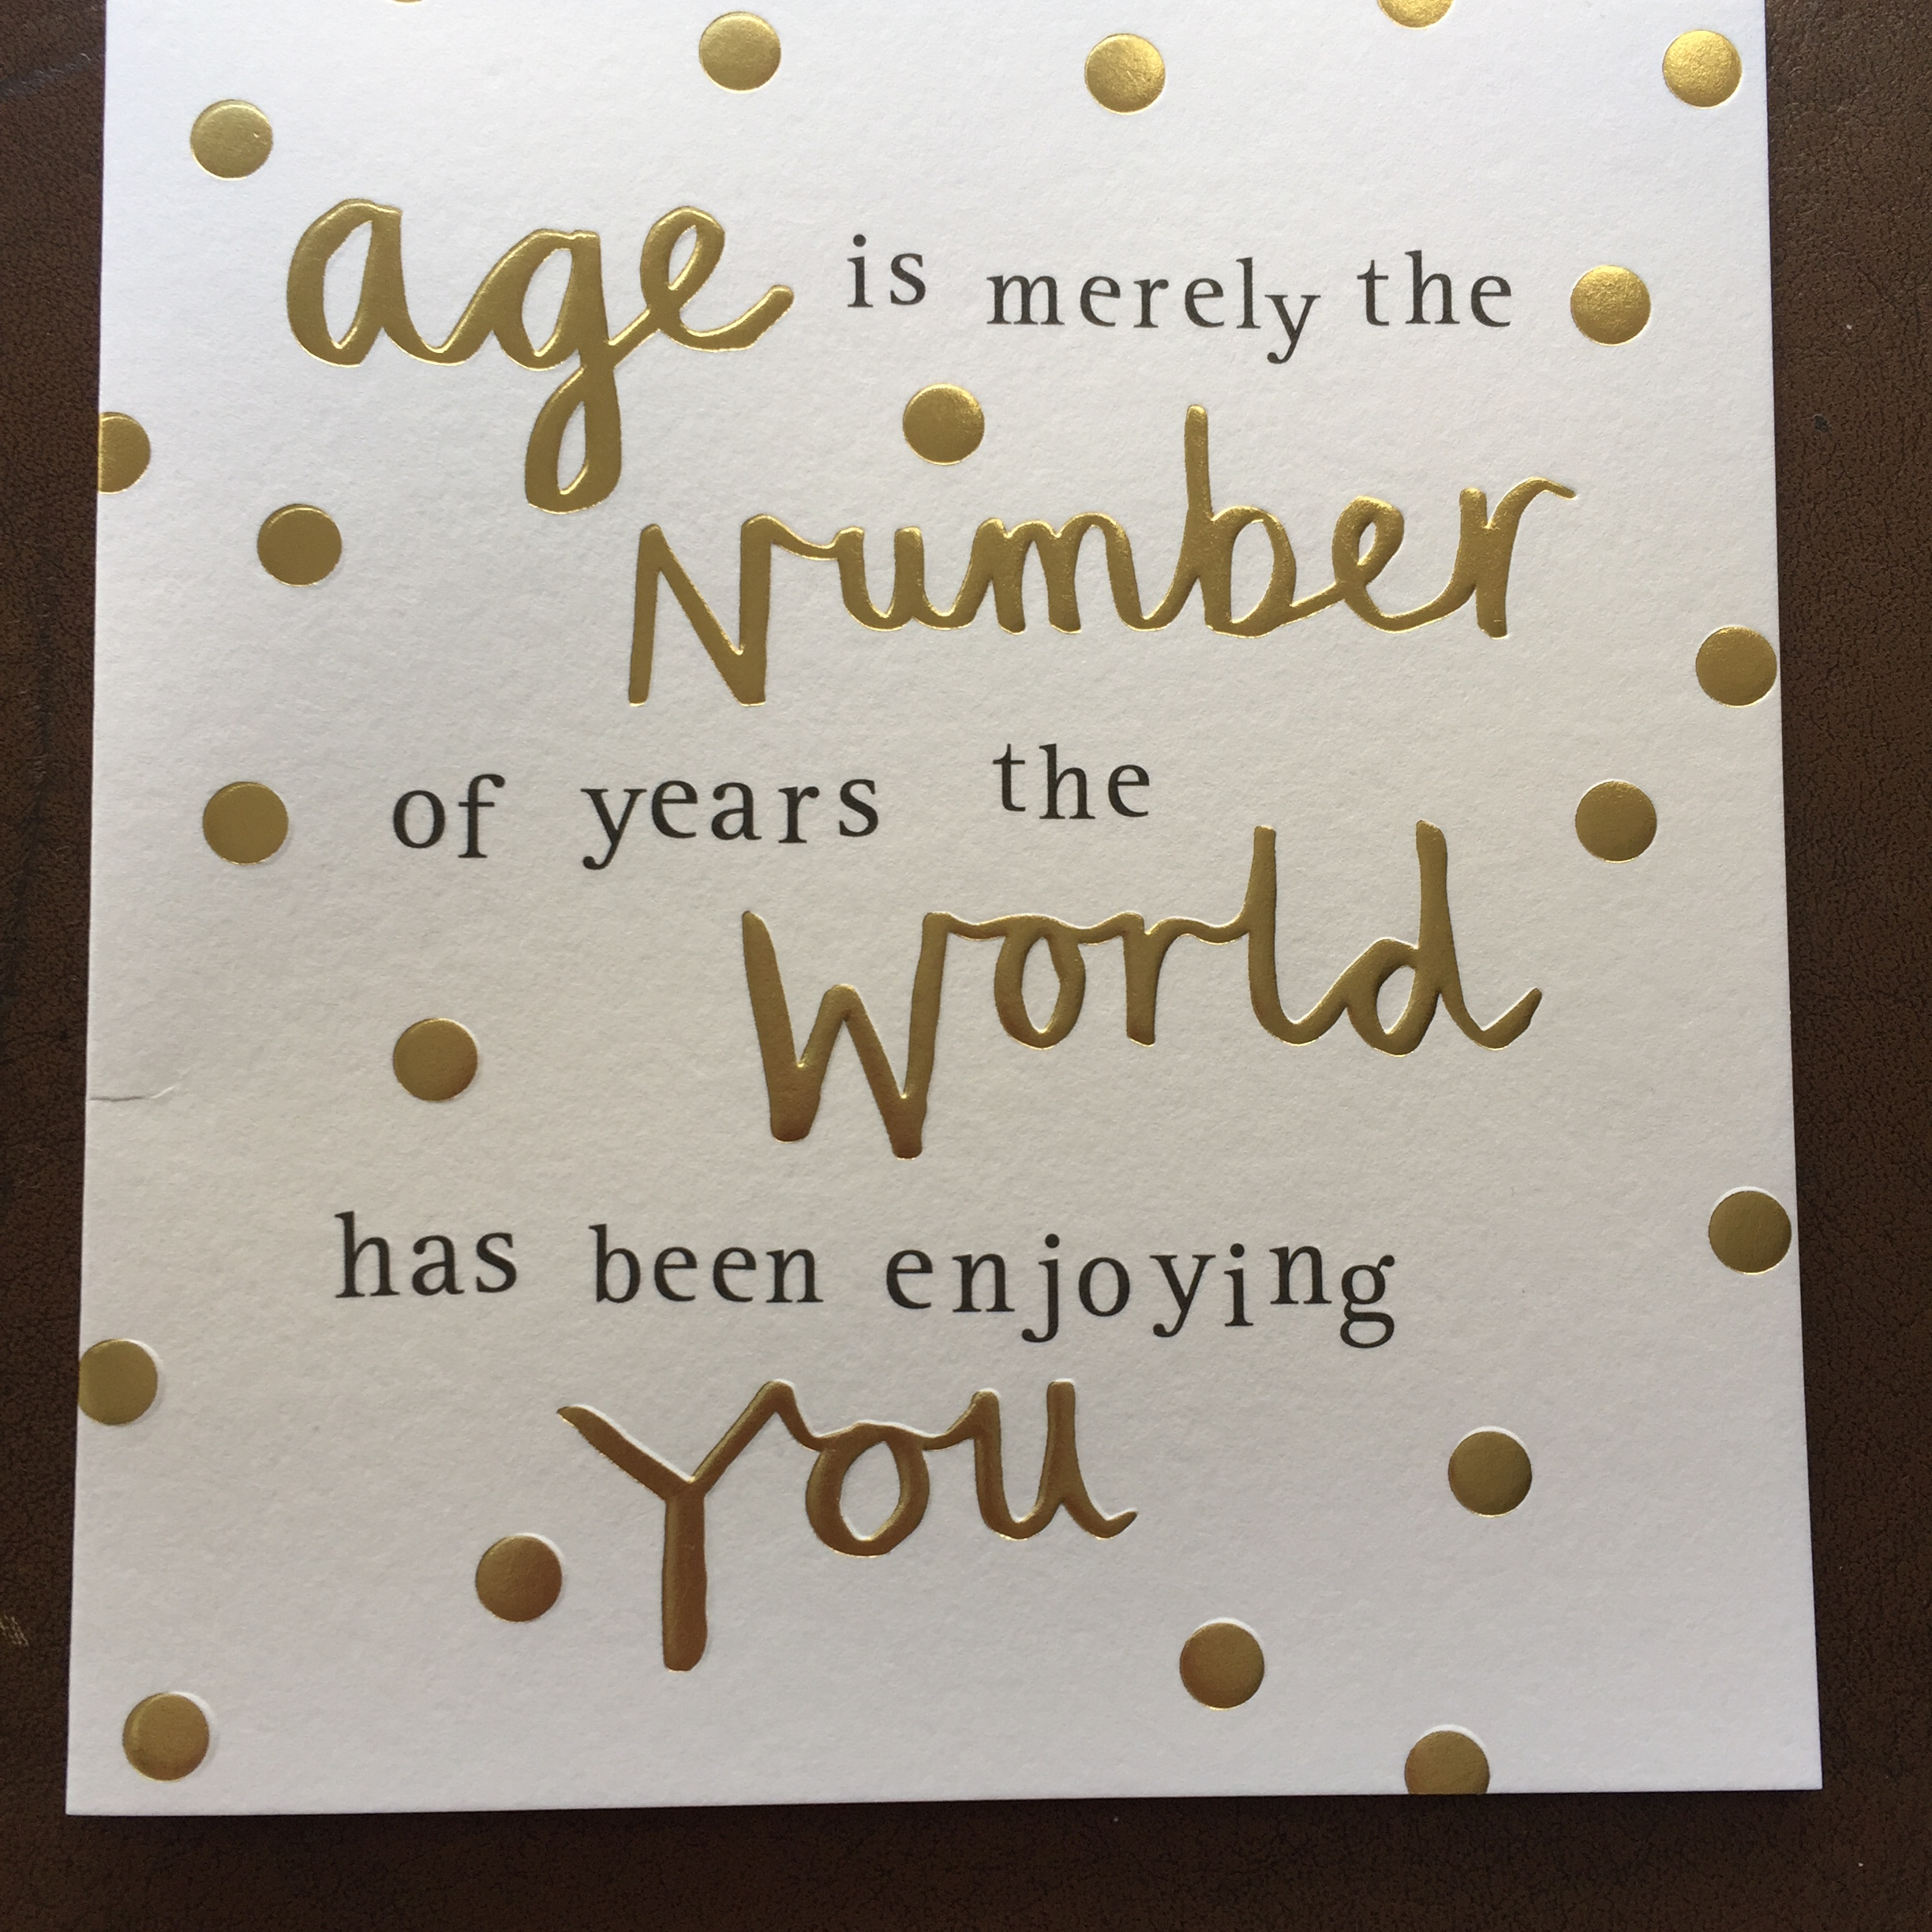

Slide 3
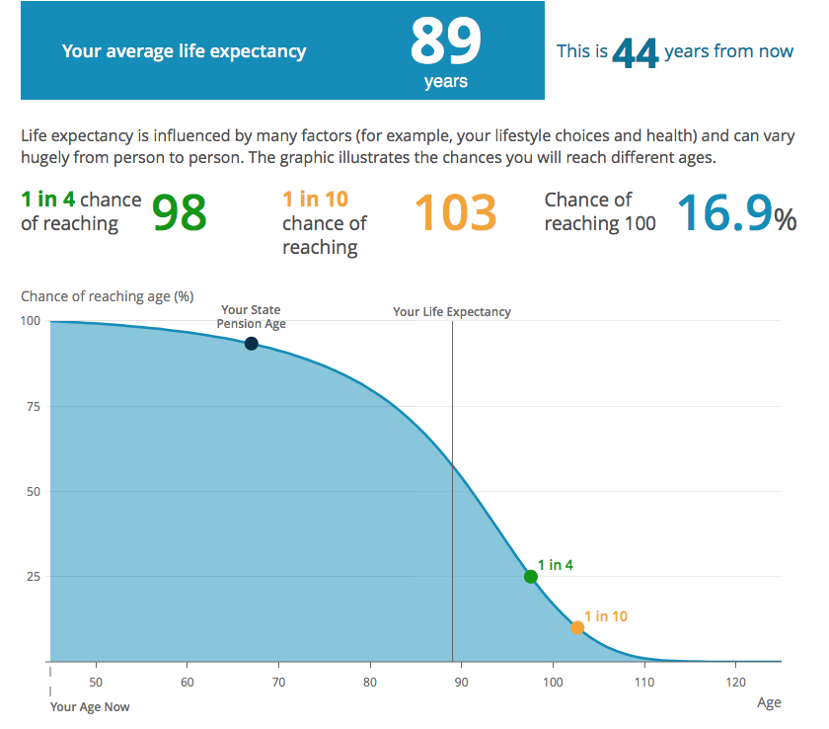

Slide 4
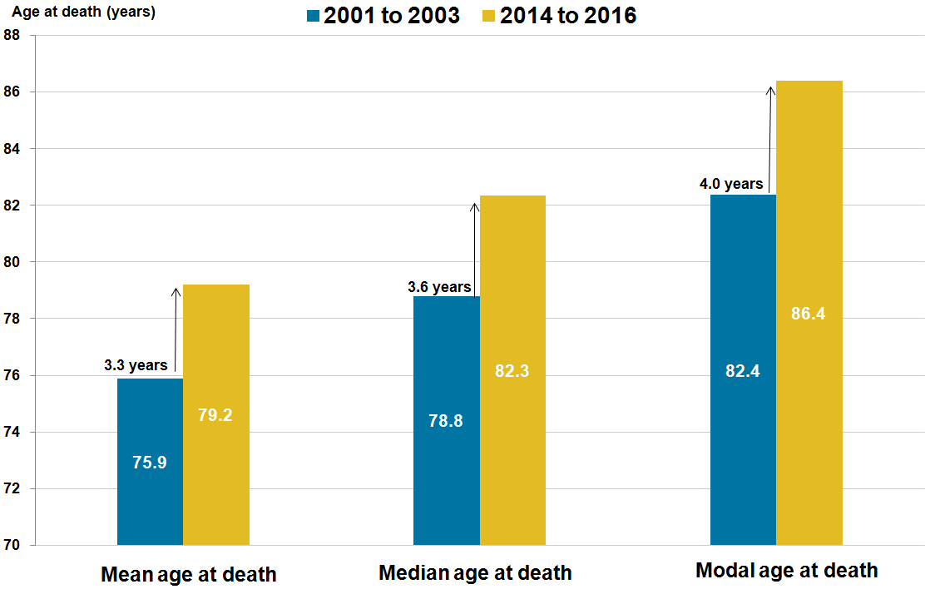
The commonest age of death for women is 86.4
Average age at death females, UK, 2001 to 2003 and 2014 to 2016
Source: Healthy state life expectancies, UK: 2014 to 2016, ONS 2017

Slide 5
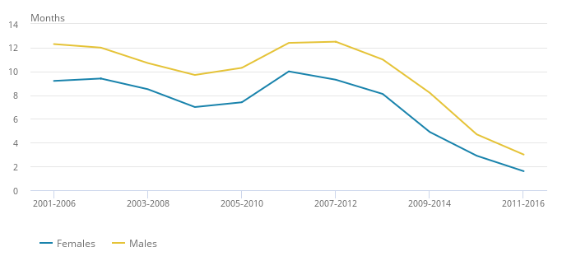
Gains in life expectancy are slowing down for both men and women
Gain in life expectancy at birth in UK by sex over rolling temporally distinct periods, 2001 to 2003 and 2014 to 2016
Source: Healthy state life expectancies, UK: 2014 to 2016, ONS 2017

Slide 6





What’s important to a good later life?
People say…
Health
Financial security
Social connections
Purpose
Source: "Later Life in 2015: An analysis of the views and experiences of people aged 50 and over” Centre for Ageing Better/ Ipsos Mori 2016
6
Notes:
This comes from our initial research with Ipsos MORI, where we were looking to understand what people in later life identify as the key dimensions to a good later life – while the full inequalities review was presented with the 6 key outcomes as chapters (Physical and mental health; Healthy life expectancy; Subjective wellbeing; Social connections; Financial security; Living environment), we have produced our own insight report where we use these 4 areas to frame our thinking – this report is our take on the findings and implications for policy and practice
We will now discuss some of the key findings on:
Financial security
Health/life expectancy
Social connections

Slide 7
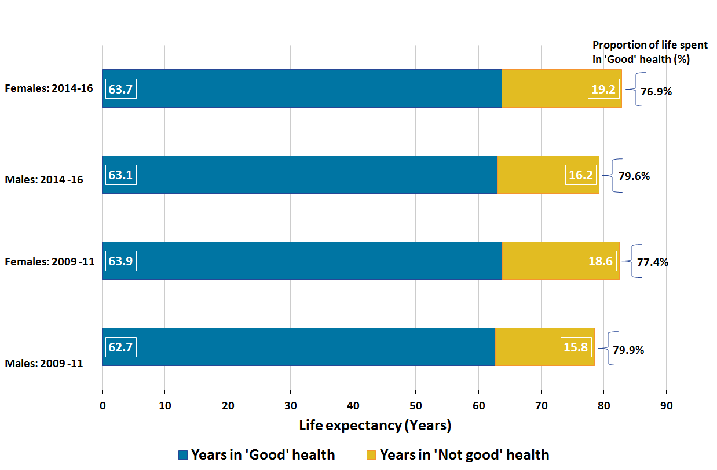
Proportion of life spent in good health declining even though life expectancy rising
Healthy life expectancy by sex in the UK, 2009 to 2011 and 2014 to 2016
Source: Health state life expectancies, UK: 2014 to 2016, ONS 2017

Slide 8
Men aged 65 years can expect to live 17.6 years of which…
11.2 years
Independent
No care needs
4 years
Low dependency
Help with shopping and housework, less than once a day
1.1 years
Medium dependency
Help with dressing and meals, several times a day
1.3 years
High dependency
Help with feeding and toileting, 24 hours a day
Source: CFAS(2017) Is late-life dependency increasing or not? A comparison of the Cognitive Function and Ageing Studies (CFAS) Lancet 390 (10103): 1676–1684

Slide 9
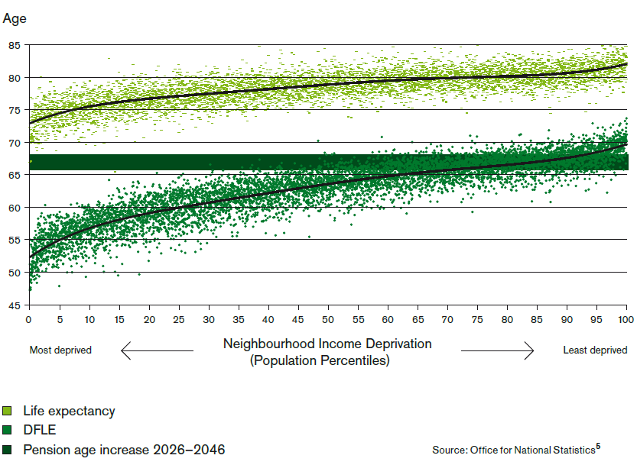
People in deprived neighbourhoods experience disability several years before state pension age
Life expectancy and disability free life expectancy at birth, by neighbourhood income level, England, 1999-2003
Source: Fair Society, Healthy Lives. Marmot Review (Executive Summary, 2010
Notes:
A review of health inequalities since 2010 in the United Kingdom found that while, on average, people could expect to live to age 77, 15 of these years would be spent with some form of disability. Moreover, both life expectancy and disability-free life expectancy varied depending on where someone lived. On average, people living in wealthier neighbourhoods in England die approximately 6 years later than those living in poorer neighbourhoods. The difference in disability-free life expectancy was even greater: 13 years. So people living in poorer areas not only die sooner, but they also spend more of their shorter lives with limitations of capacity (44). And poorer areas often lack the infrastructure and resources that might enable someone with restricted capacity to do what they need to do.

Slide 10
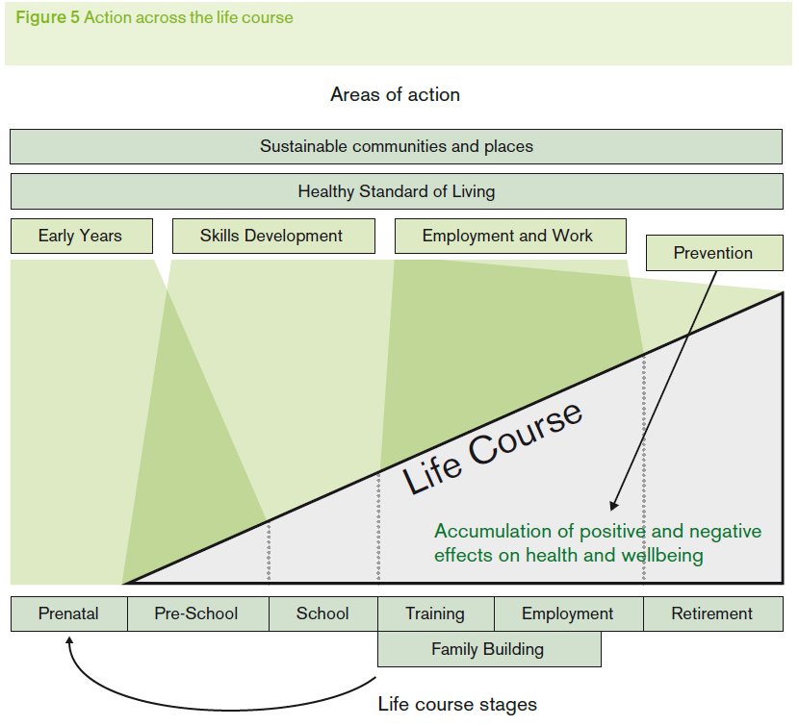
Opportunities for action at every stage of life
Source: Fair Society, Healthy Lives. Marmot Review (Executive Summary) 2010

Slide 11
Physical activity in later life
Source: Health Survey for England 2012: Health, social care and lifestyles
Notes:
Men do more then women
High intensity activity tends to decline over time, replaced with light intensity activity – which is not as good for you
People walk, men garden, women do heavy housework – all higher than leisure activities (swimming, bowls, dance)

Slide 12
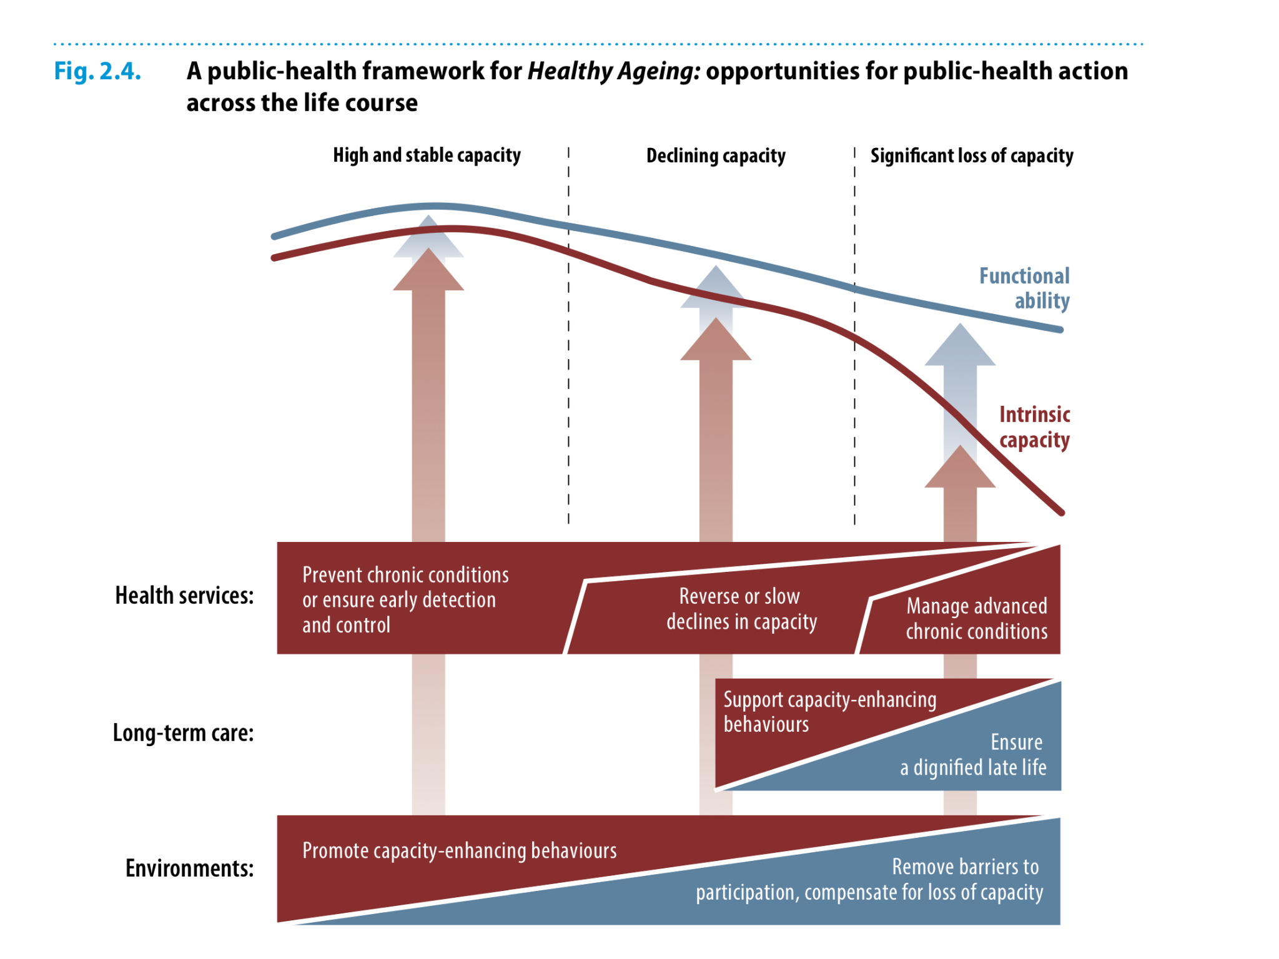

Slide 13
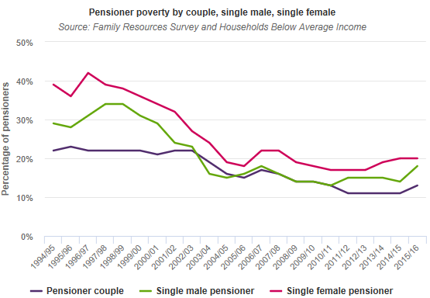
Pensioner poverty has halved since the 1990s
From: JRF: UK Poverty Data; https://www.jrf.org.uk/Data
Notes:
In the 1990s, pensioner poverty was much higher for single pensioners than pensioners in a couple, with the problem worse for women. In 1996/97, 42% of single female pensioners were in poverty while the high point for single male pensioner poverty was 34% in 1997/98.
The majority of the fall in the overall pensioner poverty rate over the following five years was due to improvements in the single pensioner poverty rates. By 2002/03 the single male poverty rate roughly matched that of pensioners in couples and the single female rate settled at about four or five percentage points higher.
However, since 2010/11, the gap between single and couple pensioners has started widening once again, with increases in poverty among single pensioners accounting for most of the growth in pensioner poverty in the three years to 2015/16.

Slide 14
But many older households are squeezed financially
Low to middle income households (LMIs) = bottom half of the income distribution with income above the bottom 10% and receiving less than one fifth of their income from means-tested benefits
1.8 million households where the head of the household is aged 50 to State Pension age. A third of all LMI households.
Struggle to maintain living standards or to save for retirement.
Proportion who are single doubled over the last 20 years to 28%
Source: Centre for Ageing Better, Resolution Foundation “ A mid-life less ordinary?” https://www.ageing-better.org.uk/publications/mid-life-less-ordinary-report

Slide 15
Reasons for exit from the labour market
“Retirement”
Health
Caring
Nearly 10m working over age of 50
Over 1.1m working over 65
Since 2008: higher employment rate for those aged 50-64 than 18-24
Redundancy
Notes:
Good news is that lots of people are working later in life. Nearly 10m working over age of 50
Main reasons for early exit are: health, caring, redundancy/unplanned retirement

Slide 16
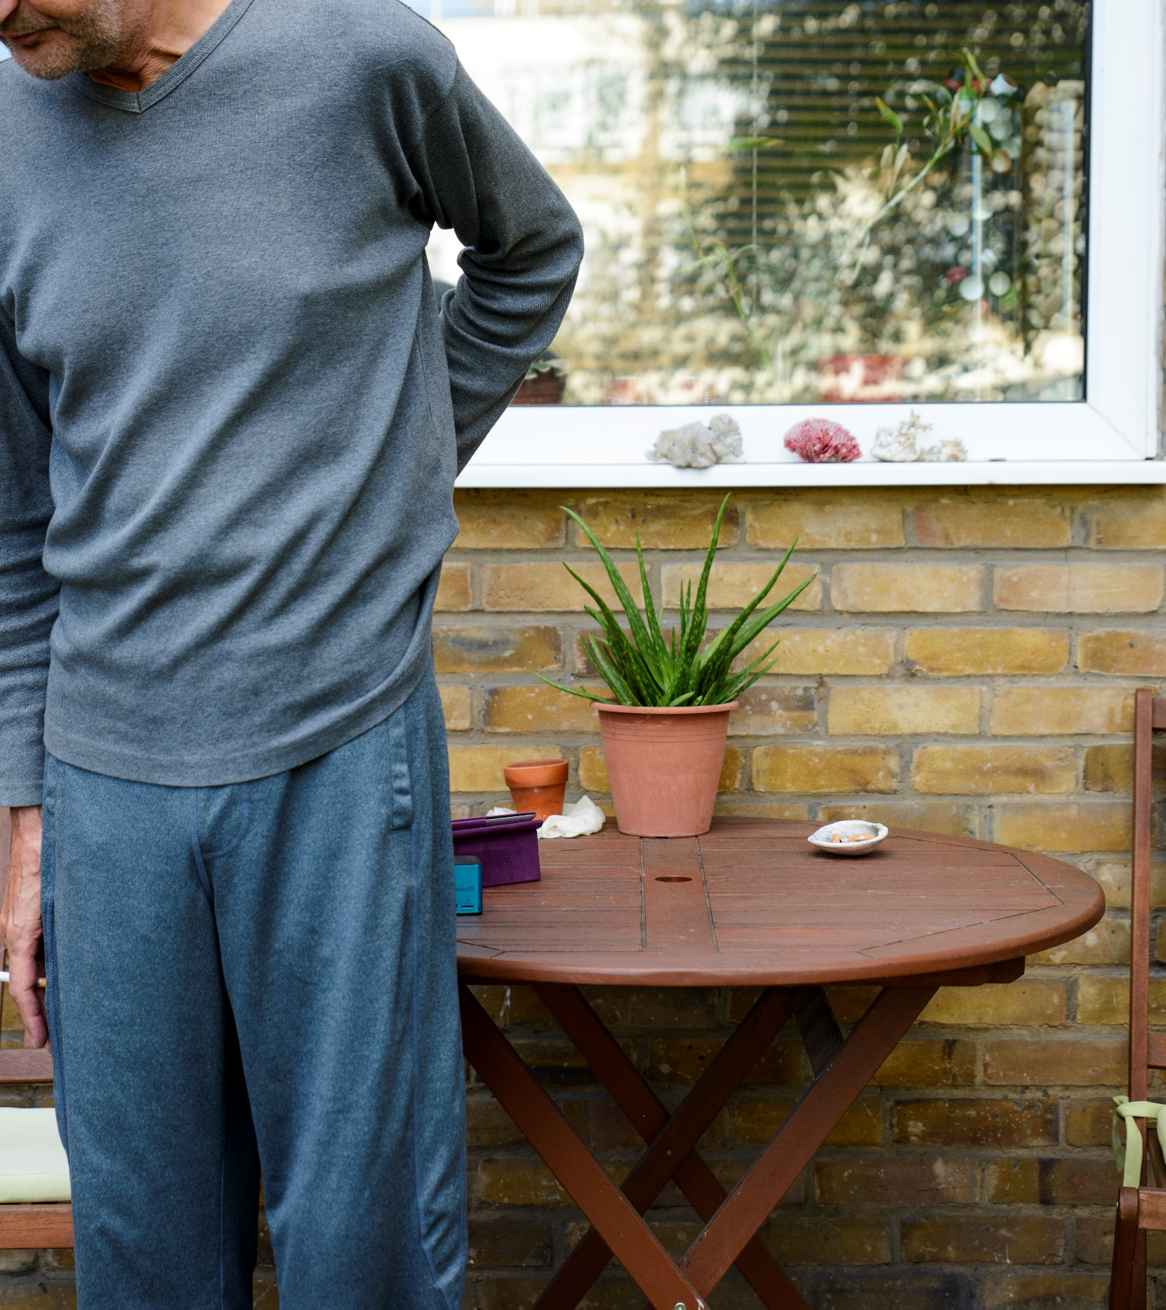
Struggling and alone
12% of those aged 50+ are the Struggling and alone
Distributed across all ages, they have long standing health conditions which affect their ability to work and build social connections. More likely to be living alone, they have fewer people they can rely on and are more likely to experience financial insecurity. They have the lowest levels of happiness of all groups.

Slide 17
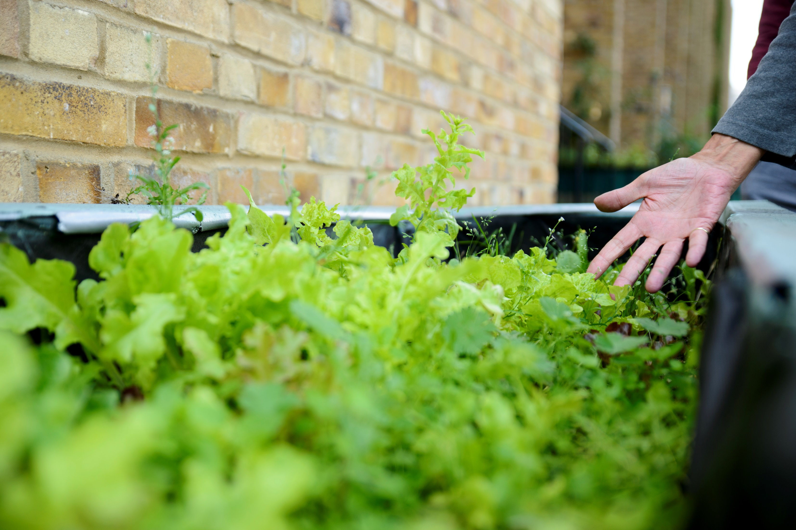
Finances are a struggle for Trevor. He has been out of work for some time as a result of his health and although he now feels that physically he is ready to go back, finding a job is proving to be very difficult.
He believes that he is facing ageism and that this is what’s preventing his return to the workforce.
At the moment Trevor does not have enough money for his needs. He depends primarily on assistance from his son and ex-partner. As Trevor struggles to get by day-to-day he has not been able to put aside much for the future. Retirement is the last thing on his mind as right now there is nothing he wants more than to get back into work.

Slide 18


“Young or old, loneliness doesn’t discriminate” Jo Cox

Slide 19
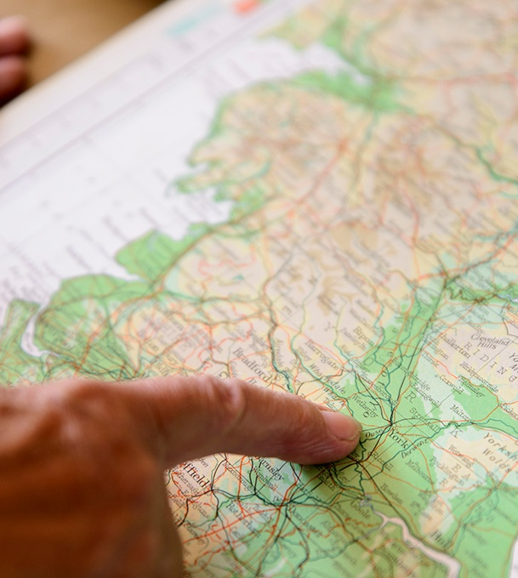
Can do and connected
19% of those aged 50+ are Can do and connected.
This segment are usually in their 70s or 80s and often widowed. Their health can be poor and they lack disposable income but they have higher than average levels of happiness. Thanks to their strong social connections they can rely on others for support, and feel fortunate for what they have.

Slide 20
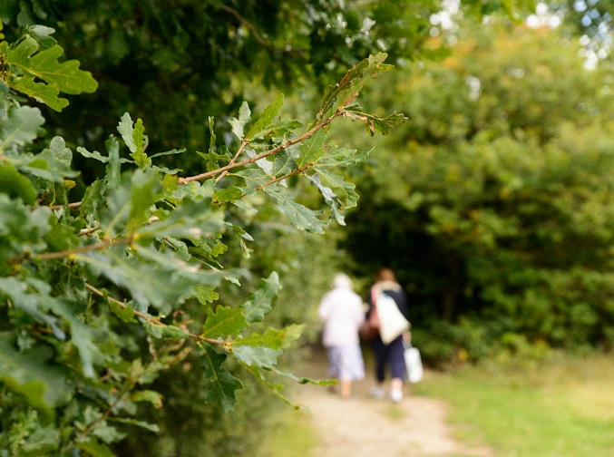
Mary is determined to stay independent for as long as possible and knows that this means taking care of her health. She watches what she eats – trying to ensure she has enough fresh food - but also exercises regularly, insofar as she can given her physical limitations. The main form of exercise she gets is walking. She walks to the shops regularly, and is also a member of the U3A’s London Explorers Club –most recently they have done a walking tour of Bermondsey.
She also volunteers in the local country park just over the road from where she lives which keeps her active.

Slide 21
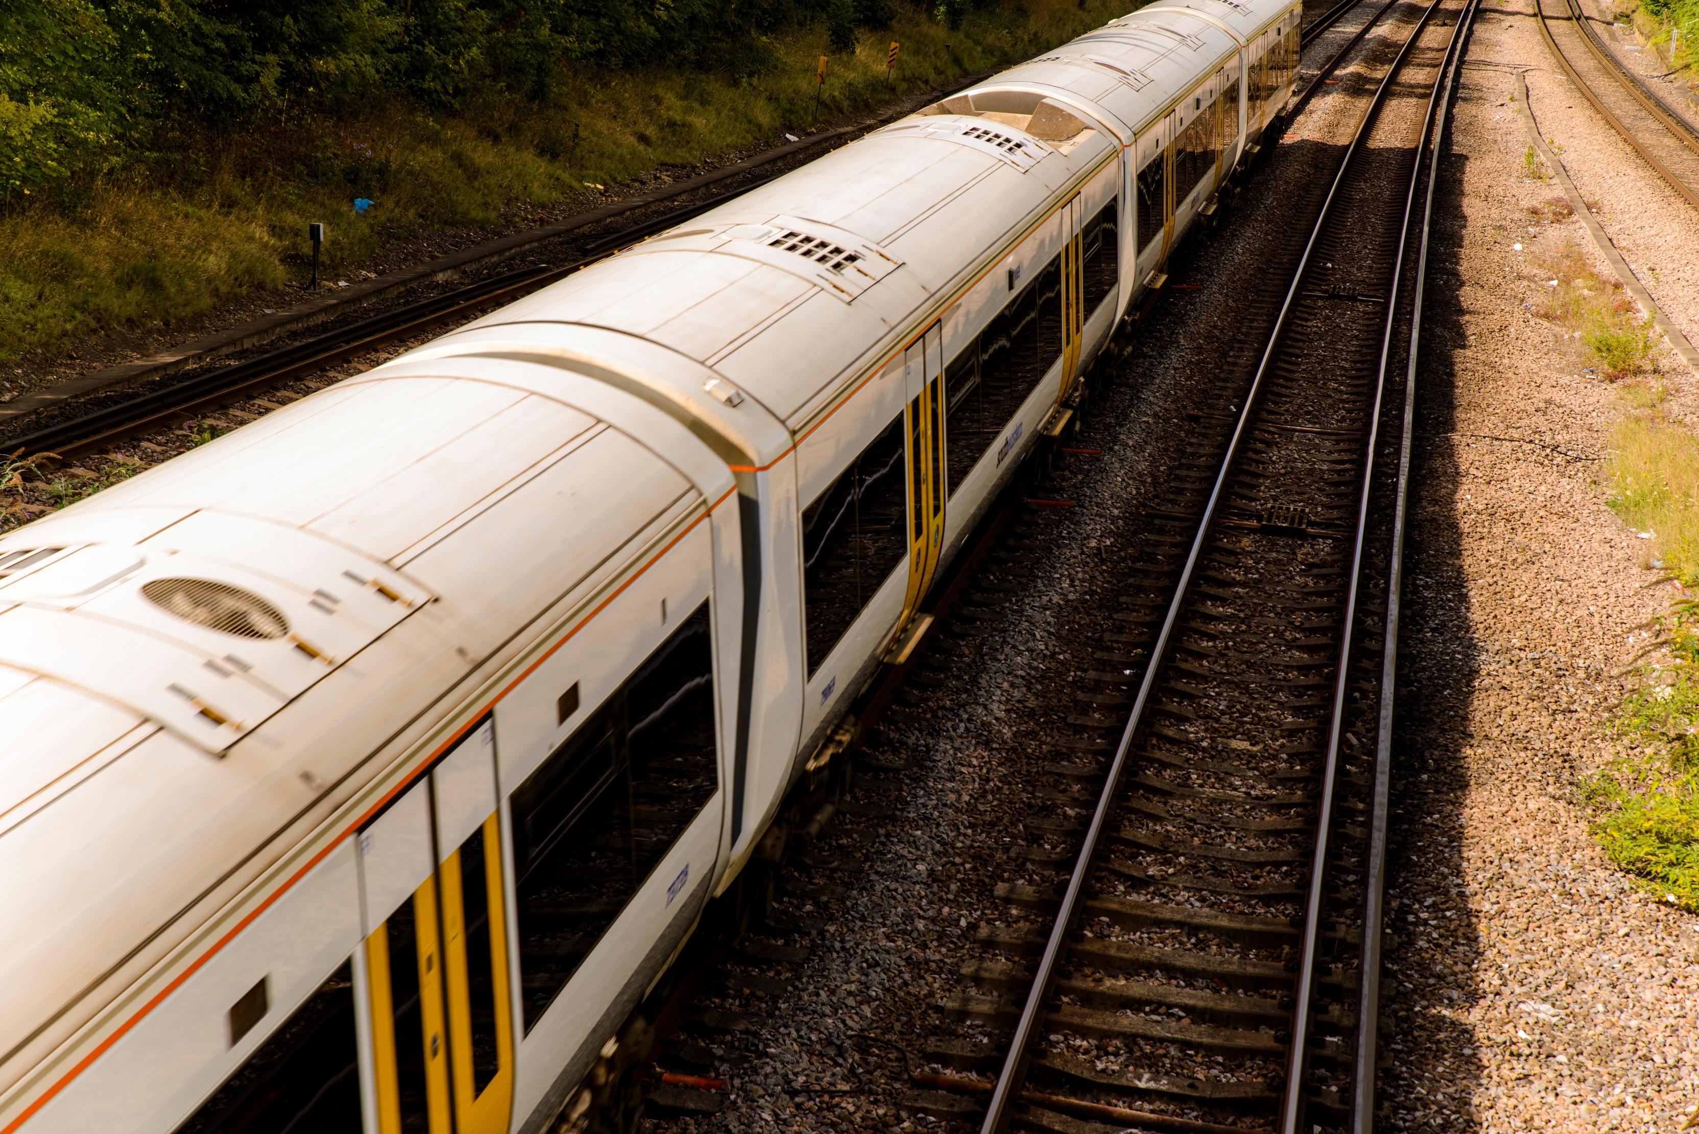
One of the things Mary most appreciates about where she lives is the transport links – she can be in central London within half an hour. This not only helps her stay in regular contact with her friends – they can meet up somewhere convenient – but it also helps keep her active by providing her with ready access to the things she enjoys doing like going to museums and the cinema.

Slide 22
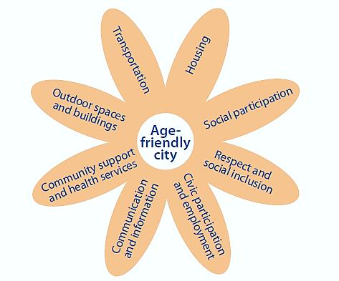
The Age-Friendly Communities Framework
Built Environment
Older people
Social Environment
22

Slide 23
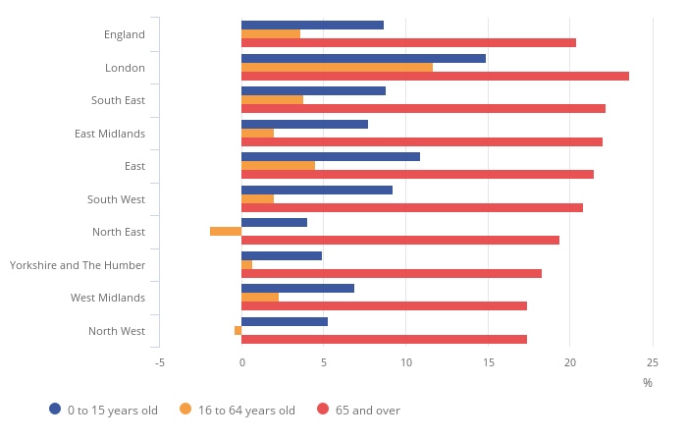
Population age 65 and over projected to increase by over 15% in the North West of England by 2024
Percentage population change in English regions by age groups, mid-2014 to mid-2024
Source: Subnational population projections for England: 2014-based projections, ONS 2017

Slide 24


Under-35s could be the first generation to earn less than their parents: Young people are hit hardest by recent pay squeezes
Millennials spend three times more of income on housing than grandparents

Slide 25
Let’s talk about contribution rather than burden…
10 million
People over 50 in the labour market
If the employment rate of people 50-64 matched that of people in their 50s would add £88 billion to GDP per annum
£11.4 billion
Estimated value of informal care provided by people over 65
1.4 million people aged 65 and over in England and Wales provide unpaid care for a partner, family member or others
£7.3 billion
Estimated value of care provided by grandparents in 2013

Slide 26
Anna Dixon
ceo@ageing-better.org.uk
@Ageing_Better
@DrAnnaDixon

